Slide 1
Secure Data Hiding in Image Using Steganography
CAPSTONE PROJECT
Presented By: Tanishka Sharma
Student Name : Tanishka Sharma
College Name & Department :
Indraprastha College For Women ,Delhi , Computer Science

Slide 2
OUTLINE
Problem Statement
Technology used
Wow factor
End users
Result
Conclusion
Git-hub Link
Future scope

Slide 3
Problem Statement
The project aims to develop a secure image steganography technique for hiding sensitive data within images. It focuses on ensuring the concealed data remains undetectable, secure from unauthorized access, and resistant to common image manipulation. The goal is to enhance the capacity of hidden data without compromising the image quality, offering a solution for secure communication and data protection.

Slide 4
Technology used
1.Python Idle:
2. Libraries used in python : cv2,string,os
3. GitHub
4.Png to jpg changer
5.Windows 11

Slide 5
Wow factors
Strong Encryption: Integrates advanced encryption techniques to secure hidden data and prevent unauthorized access.
High Data Capacity: Maximizes the amount of data that can be embedded in an image without visual distortion.
Robustness Against Manipulation: Ensures resistance to common image manipulations like compression resizing, and noise addition.
Undetectability: Optimizes embedding algorithms to make hidden data undetectable through statistical or detection methods.
Enhanced Security: Focuses on providing a more secure and reliable steganography solution compared to traditional methods.

Slide 6
End users
Individuals: For securely sharing sensitive information over insecure channels.
Organizations: To protect proprietary or confidential data during transmission.
Government & Military: For secure, hidden communications of classified information.
Digital Artists/Creators: To watermark and protect digital content from unauthorized use.
Cybersecurity Professionals: For implementing secure communication methods and preventing
data breaches.

Slide 7
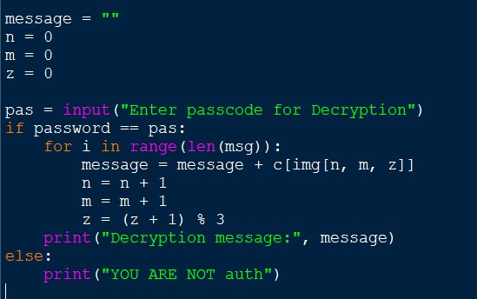
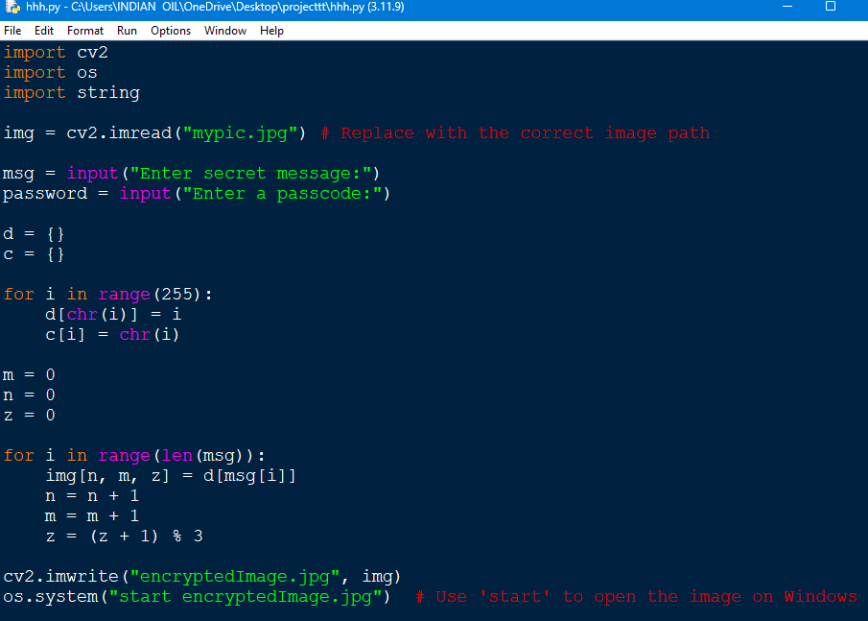

Results
OUTPUT PICTURE:
This is the screenshot pic that’s being encrypted

Slide 8
Conclusion
In conclusion, the Secure Data Hiding in Image Using Steganography project offers a robust and efficient solution for protecting sensitive information by embedding it within images. By combining strong encryption, high data capacity, and resistance to common image manipulations, the project ensures that hidden data remains secure, undetectable, and intact. This innovative approach has wide applications across various sectors, including personal communication, corporate data protection, government security, and digital content protection, making it an essential tool for secure and private digital communication.

Slide 9
GitHub Link
https://github.com/Tanishka2301/aicteproject.git

Slide 10
Future scope(optional)
The future scope of the project includes:
Expanding steganography to hide data in audio, video, and documents.
Using AI to improve the embedding process and enhance security.
Applying the system to real-time communication platforms for secure messaging.

Slide 11
THANK YOU

